Slide 1
CS 2710, ISSP 2610
Chapter 5
Constraint Satisfaction Problems

Slide 2
CSP
Previous framework:
  state is a black box, only accessed via goalp, successors, edgecost, h
  Heuristic, h, is problem specific
CSP framework:
  States and goals in standard, structured representation
  Algorithms exploit structure of the state
  General purpose rather than problem specific heuristics

Slide 3
CSP
Variables: X1, X2, …, XN
Xi has domain Di of possible values.
Constraints: X1, X2, …, XM.
  Each involves a subset of the vars
  Specifies allowable combos for that subset
State: assignment of values to some or all vars

Slide 4
CSP
An assignment that does not violate any constraint (but may not mention all variables) is consistent or legal
An assignment that mentions all variables is complete
Solution: complete assignment that satisfies all of the constraints.
Sometimes, solutions must maximize an objective function. Or, objective function used to choose among solutions.

Slide 5
Example Problems
Map Coloring (on board)
8-queens (on board)
Course / room scheduling
  Each course has a room
  Each room has no more than one course at a given time
  Additional constraints (e.g. size, projector)
Cryptarithmetic
Line Labeling

Slide 6
A Cryptarithmetic Problem
SEND + MORE = MONEY
Constraints
  S≠E≠N≠D≠M≠O≠R≠Y (rules)
  M = 1 (It is a carry out of the high-order digit)
  S ≠ 0 (no leading 0s)
  D+E = Y or D+E=10+Y
  N+R = E or N + R + 1 = E or N + R = 10 + E etc.

Slide 7
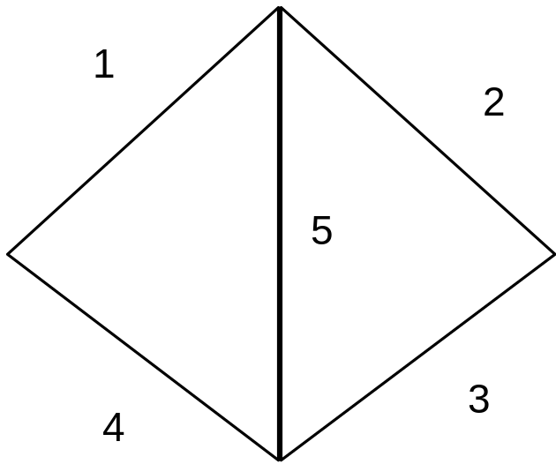

Line Labeling
Label each line in the picture (left)
Constraints based on vertices (“L” and “arrow” vertices shown)
Both ends of the segment must have the same label!
>
>
<
<
+
<
<
+
–
>
>
–

Slide 8
Domains
Finite domain (fixed number of variables, possible assignments)
Discrete variables with infinite domains (e.g. integers, strings)
  Cannot search by enumeration, need a language to represent constraints
Continuous variables (e.g. real numbers)
  Linear programming and other continuous optimization techniques

Slide 9
Constraint Problem as Search
Formulation
Order of assignments doesn’t matter
  Initial state: no assignments
  Successor function: all assignments to *one* variable that do not violate any constraints
  Goal test: all variables are assigned
  Path cost: constant for each step
Known solution depth (# of variables)
Appropriate search is depth-limited DFS

Slide 10
Backtracking Search for CSP’s
Pick an unassigned variable
For each possible value that meets constraints
  Assign the value
  If all variables are assigned, return the solution
  Recursively solve the rest of the problem
  If the recursion succeeded, return the solution
Return failure

Slide 11
Searching More Efficiently
Choose the most constrained variable (fewest legal values) to assign next
  # of iterations of loop is minimized
  “MRV” Minimum Remaining Values heuristic
In case of tie, choose the variable that is involved in the most constraints (highest degree)
Once a variable is chosen, choose the least constraining value, i.e. rule out the fewest future choices

Slide 12
Constraint Propagation
Forward checking
  Whenever a variable is assigned, delete inconsistent values from other domains
  Works well with MRV heuristic
General constraint propagation
  Consider results of constraints between variables affected by forward checking
  Arc consistency: for each assignment, there must be a consistent assignment at the other end of the arc (in the constraint graph)
  Tradeoff between consistency checking (takes time) and overall search time

Slide 13
AC-3
Function AC-3 (binary csp problem)
Queue = all the arcs in csp
While queue not empty:
(Xi, Xj) ← queue(0)
if remove-incon-values (Xi,Xj):
for each Xk in neighbors(Xi):
add (Xk,Xi) to queue
Function remove-incon-values(Xi,Xj):
Removed ⬅ false
For each x in domain(Xi):
if no value y in domain(Xj) lets (x,y) satisfy (Xi,Xj) constraint
delete x from domain(Xi); removed ← true
Return removed

Slide 14
Chronological vs. Intelligent Backtracking
Chronological Backtracking
  Undoes most recent decision
Intelligent Backtracking
  Undoes the decision that caused the problem in the first place!
  Set of variables that caused the failure is “conflict set”
  Backjumping: undo most recent variable in conflict set (redundant with forward-checking)

Slide 15
Local Search for CSP
Hill Climbing with min conflicts as heuristic
Every state is a complete assignment, count how many variables are conflicted (violate constraints)
At each step: choose a conflicted variable at random, change its assignment to the value that causes the minimum number of conflicts
Surprisingly effective for many CSP’s e.g. N-queens problem
Does depend (like all hill climbing) on initial state though.

